Slide 1

SOPA Eastern Fall Sectional 2021 Market Research Project
Team E:
Cole, JC, Kurtis, Mark, Tommy, and TJ
Notes:
JC

Slide 2
Table of Contents
Research Objectives
Research Design and Methods
Data Summarization
Recommendations
Notes:
JC

Slide 3
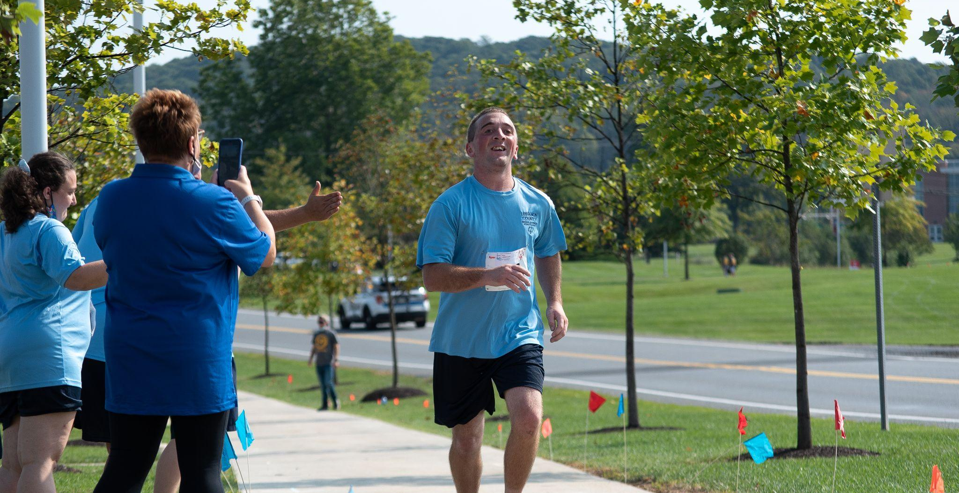
Research
Objectives:
To measure the attitudes and preferences of:
Special Olympic Athletes
Spectators
...regarding the DeSales Eastern sectional event
Notes:
TJ

Slide 4
Data Collection Methods
Secondary Research
SWOT Analysis
Environmental Analysis
Primary Research
Surveys
Direct Observation
Focus Group
Notes:
Kurt

Slide 5
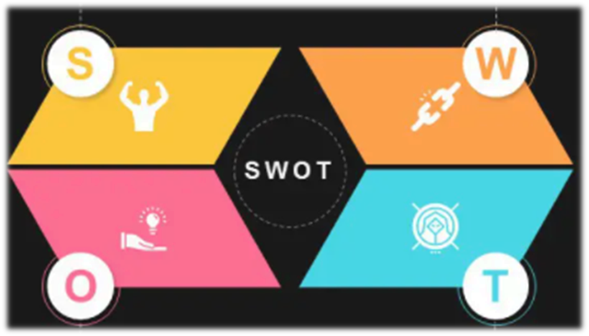
SWOT Analysis
STRENGTHS | WEAKNESSES
Large volunteer network Established brand Program depth | Lack of consistency across chapters Inconsistent volunteer training
Notes:
Kurt

Slide 6
SWOT Analysis
OPPORTUNITIES | THREATS
University partnerships Unified Sports program | Competing programs Volunteer dependency & retention
Notes:
Kurt

Slide 7
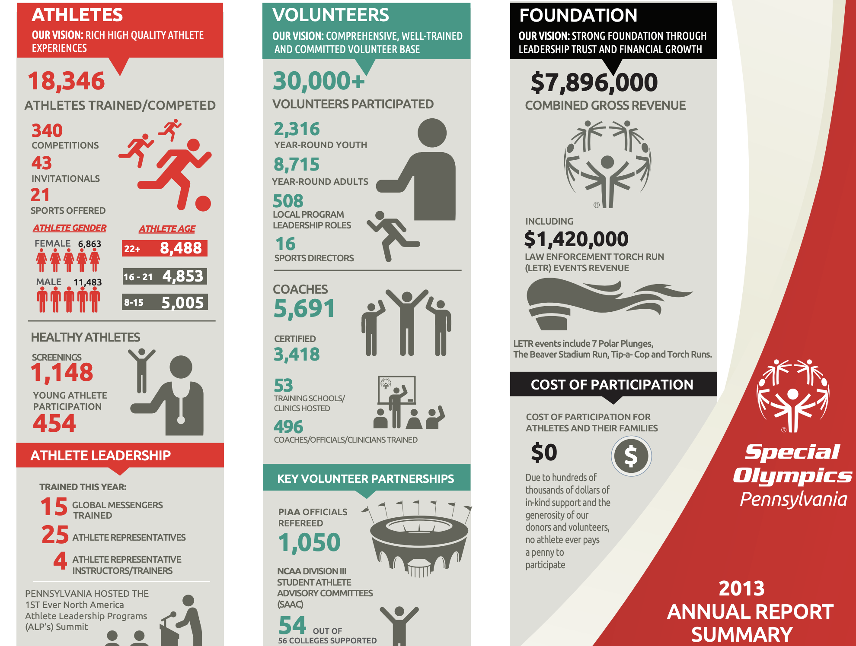
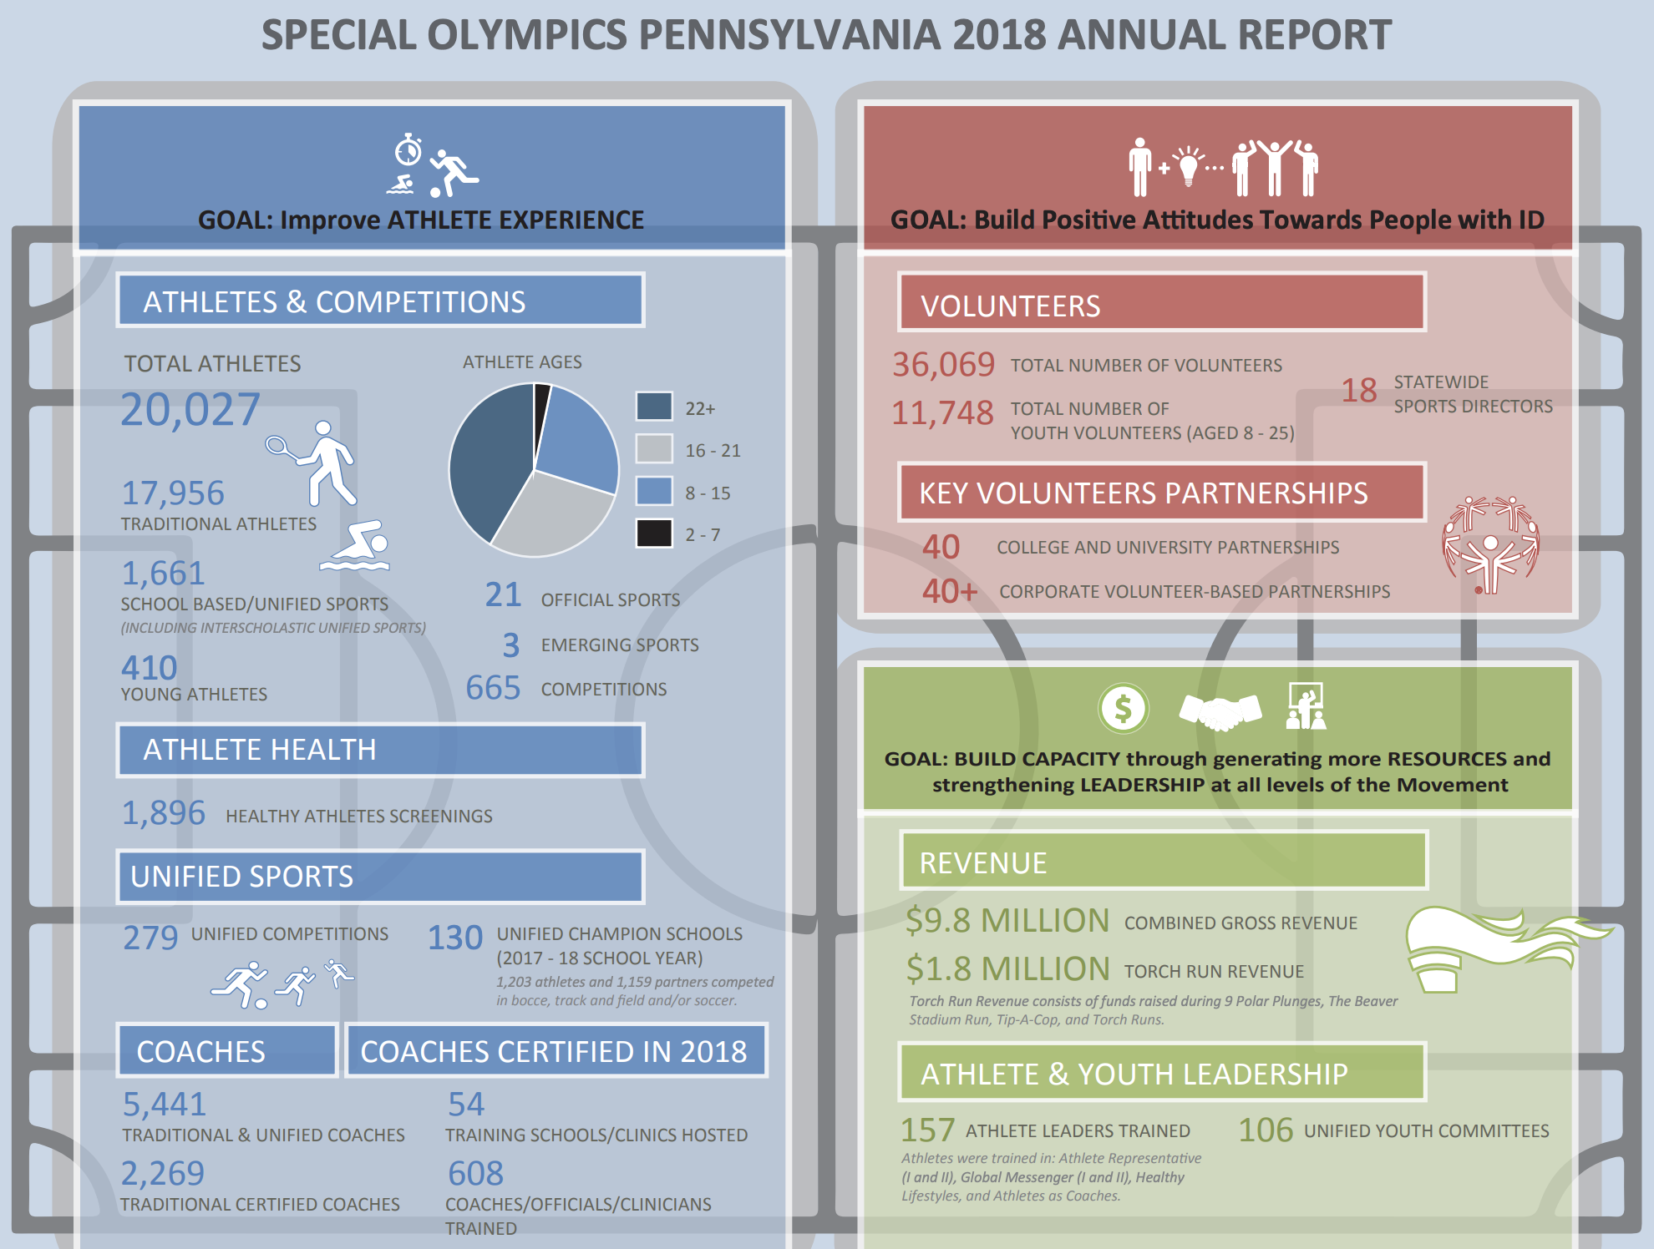
Environmental Analysis - Market Size
The number of athletes that competed in (SOPA) increased by 9% from 2013 to 2018
This increase in market size helped guide us to our conclusions about potential parking and accessibility challenges that may be encountered in future years
There was a 20% increase in the number of volunteers at Special Olympics events from 2013 to 2018
Notes:
TJ

Slide 8
Environmental Analysis - COVID-19
One of biggest environmental factors that influenced Special Olympics is COVID-19
The fear of contracting and spreading COVID-19 may have impacted the participation for the most recent Special Olympics event
Due to ongoing COVID-19 concerns, certain policies were implemented such as wearing masks indoors and sanitizing equipment
Notes:
TJ

Slide 9
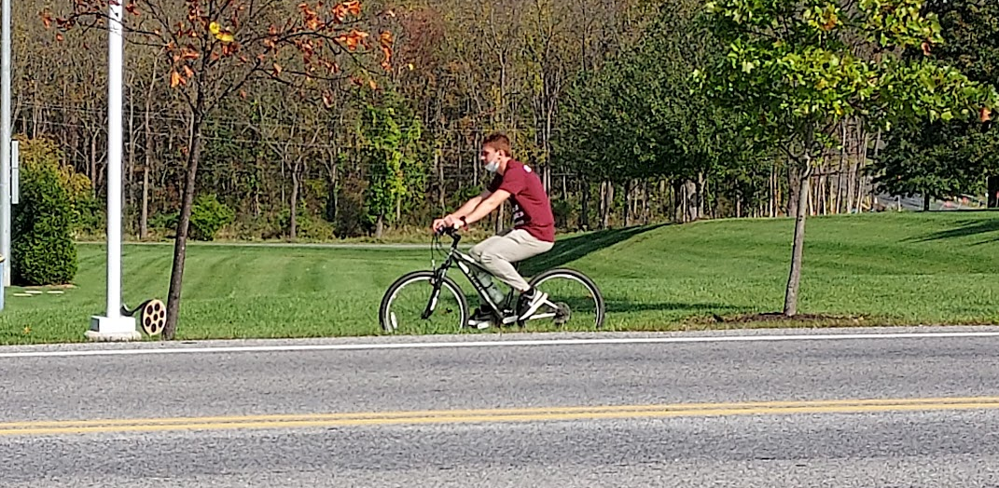
Data Collection Methods - LDR Observations
Positive feedback:
COVID-19 regulations were very thorough
People were very happy to be back to DeSales!
Negative feedback:
Bathrooms were not open initially
Spectators were upset that the starting line was far away
Athletes were confused by the course
Optimize volunteer time so shifts line up with race time
Some teams opposed being surveyed
Notes:
JC

Slide 10
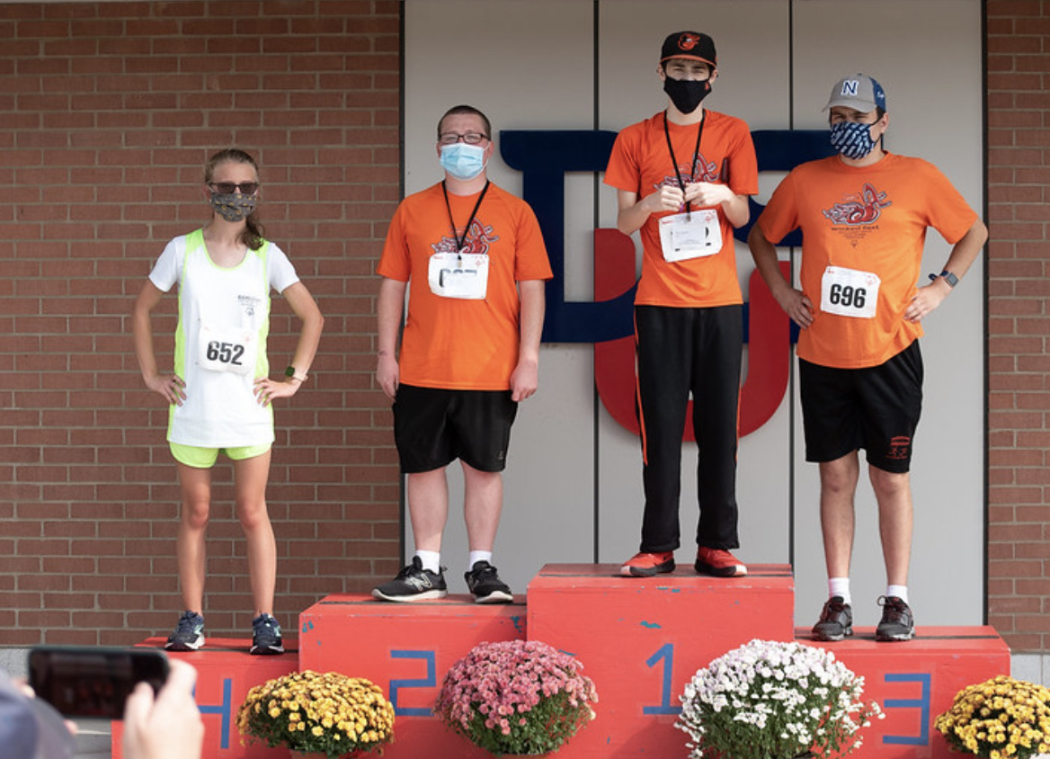
Sampling Plan
Who was involved with our research?
Athletes
Athlete’s Family
Friends supporting the runners
Coaches
How were they chosen:
Availability
Willingness
Enthusiasm
Notes:
JC

Slide 11

Data Collection Methods - Focus Group
Focus Group Participants:
6 volunteers participated:
4 education majors
1 nursing major
1 business major
All six in bocce
Notes:
Mark

Slide 12
Focus Group Cont.
Q. What prompted you to volunteer?
Character U (2)
Sports team
Volunteer for the experience (2)
Q. How many hours of training received for the volunteer role?
Bocce volunteer coordinator: ~2 hours
Other bocce volunteers: 5 - 15 minutes and a training video
Q. Do volunteers require more training?
Don’t think there’s a need for more training
There are training events, but they did not attend
Learned the rules of bocce the day of!
Notes:
Mark

Slide 13
Focus Group Cont.
Q. Was the variety of food for athletes sufficient?
The same food was offered
Not much variety or alternative options
Q. How well were events organized?
Not that poorly planned
Higher ups had trouble communicating with each other
Bocce was close in proximity, there were no problems
Notes:
Mark

Slide 14
Focus Group Cont.
Q. How likely are you to recommend volunteer opportunities to friends and family members?
Everybody answered “Very Likely”
There were all returning volunteers
Q. Was the event safe for COVID-19?
Bocce was very safe: masks on all the time, cleaned and sanitized balls in between sets, kicked balls back, no touching
Other sports also safe with social distancing and sanitization
Q. Were there any surprises on the day of the event?
Talent level of the athletes
Successful event compared to years past even with covid protocols
Notes:
Mark

Slide 15
Focus Group Cont.
Q. Were there any challenges that may be important for future planning?
More training for bocce referees (occasionally had to ask the coaches for assistance)
One was asked to go from bocce where she signed up to help flag football and medals which felt unorganized.
Q. Were you given safety training regarding the health and well being of athletes in case of a medical problem?
Everybody answered no
Q. Would you volunteer for special olympics after graduation or in your hometown?
Everybody claimed they definitely would if it was near them
Notes:
Mark

Slide 16
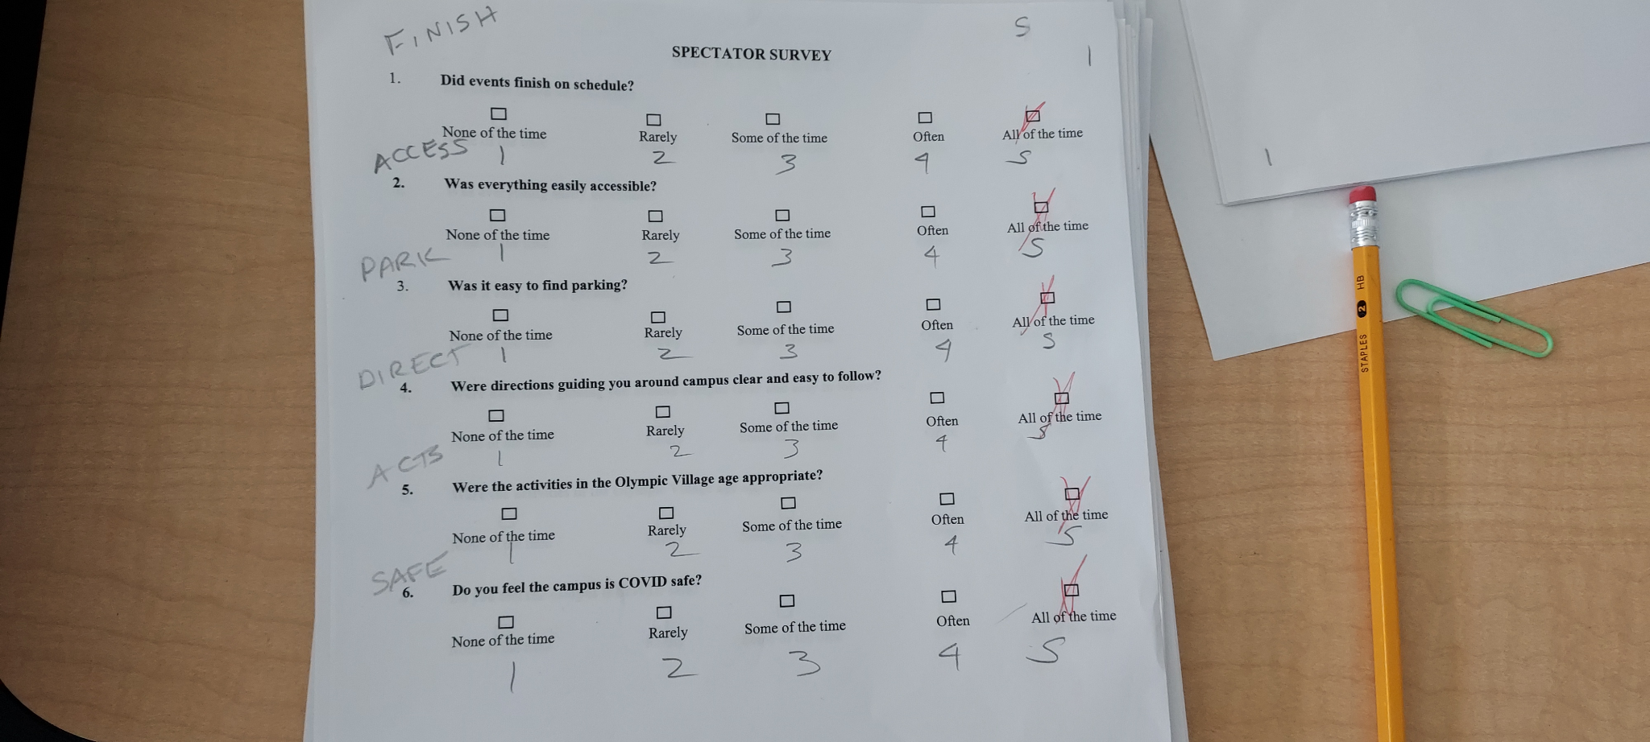
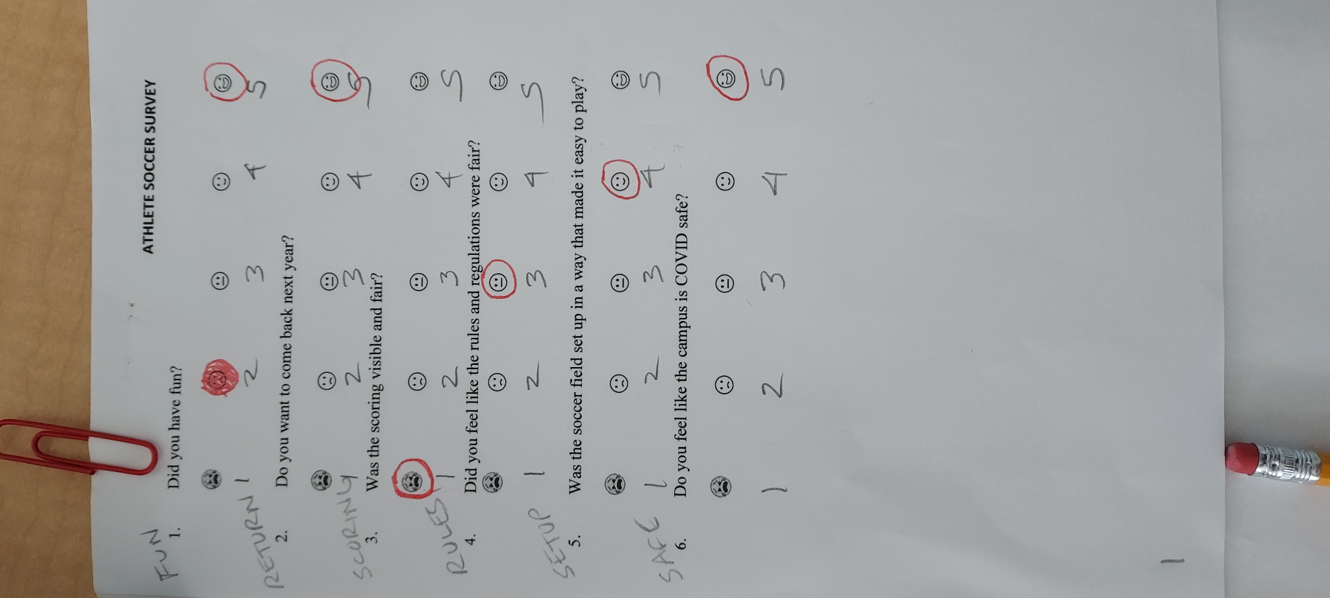
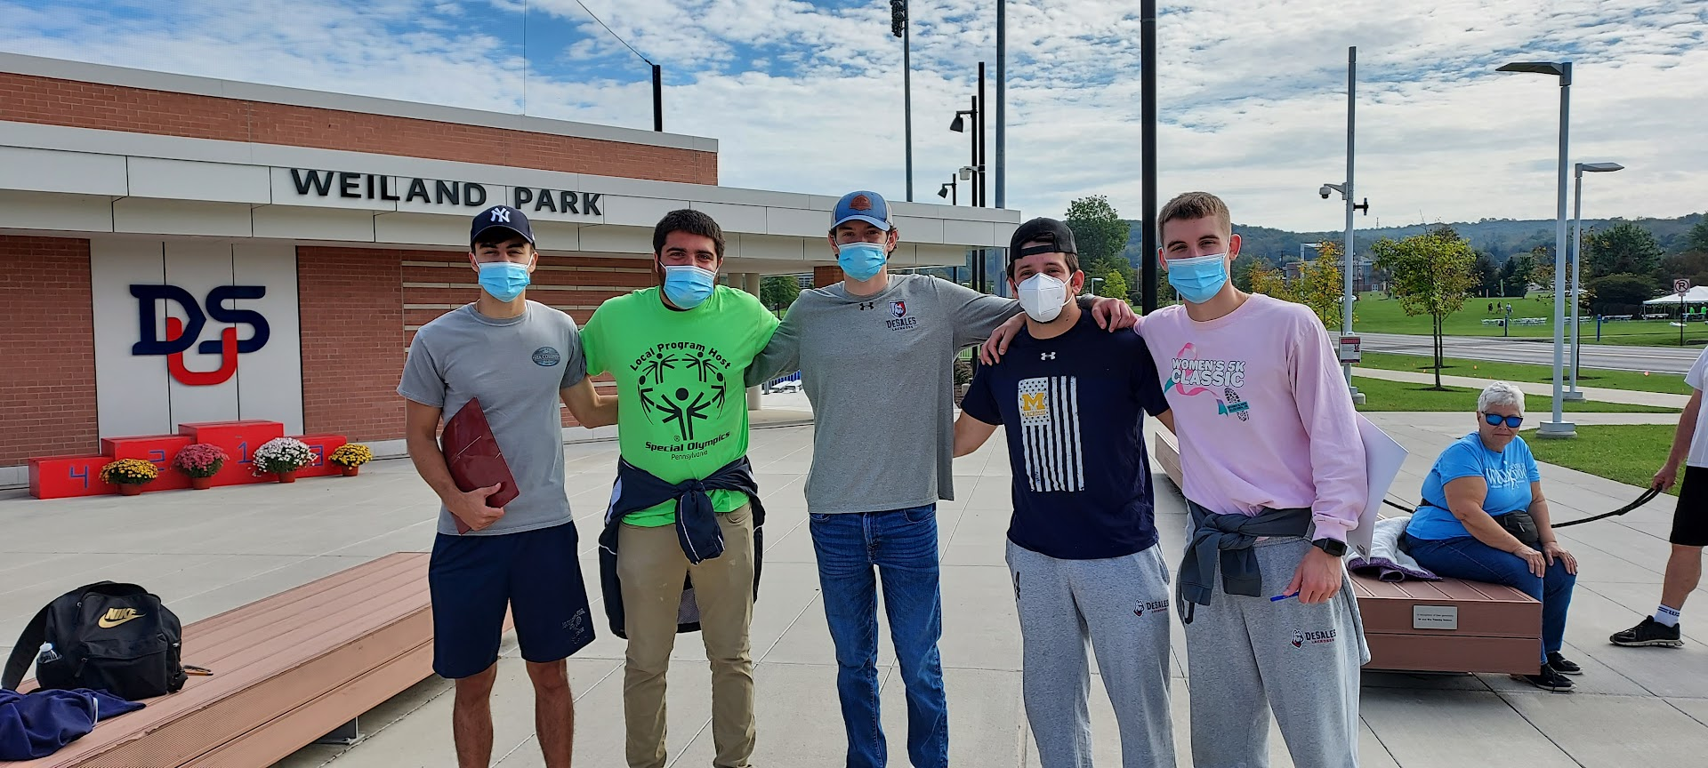
Data Collection Methods - Surveys
Notes:
Cole

Slide 17
Data Summarizations
3 statistically significant survey questions:
ATHLETES:
Was the scoring visible and fair?
SPECTATORS:
Was everything easily accessible?
Was it easy to find parking?
Notes:
Cole

Slide 18
Data Analytics Methods
Chi-Square Test:
Used to determine difference between groups
Distribution of counts
Analysis of Variance Test:
Used to analyze differences among means
Tukey Comparisons: find statistically similar groups
Boxplot
Displays pertinent quartile percentages
Displays 95% confidence interval
Notes:
Tommy

Slide 19
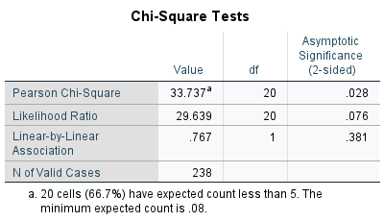
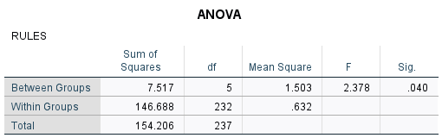
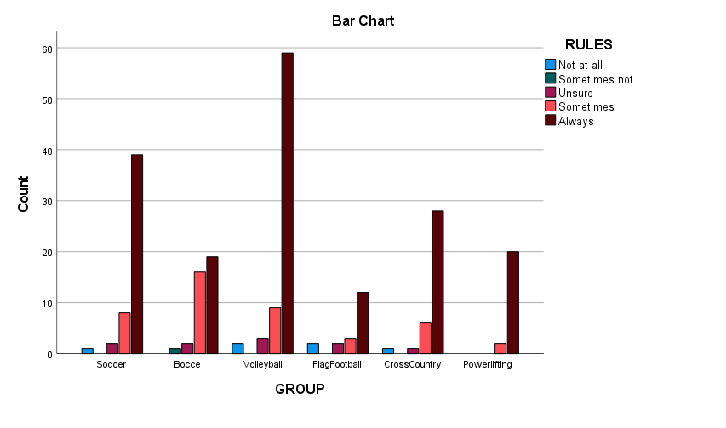
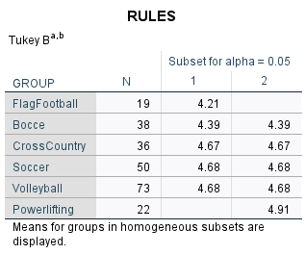
Athlete
GROUP x RULES
Notes:
Tommy

Slide 20
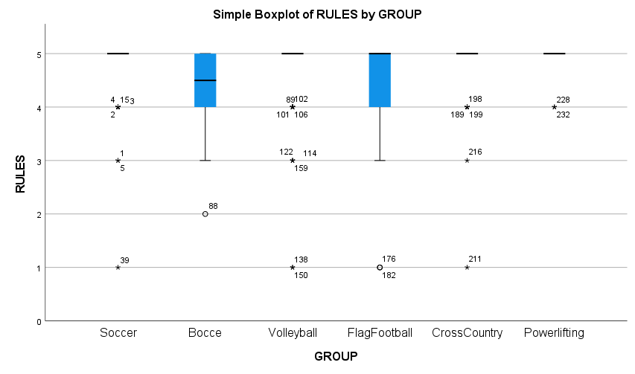
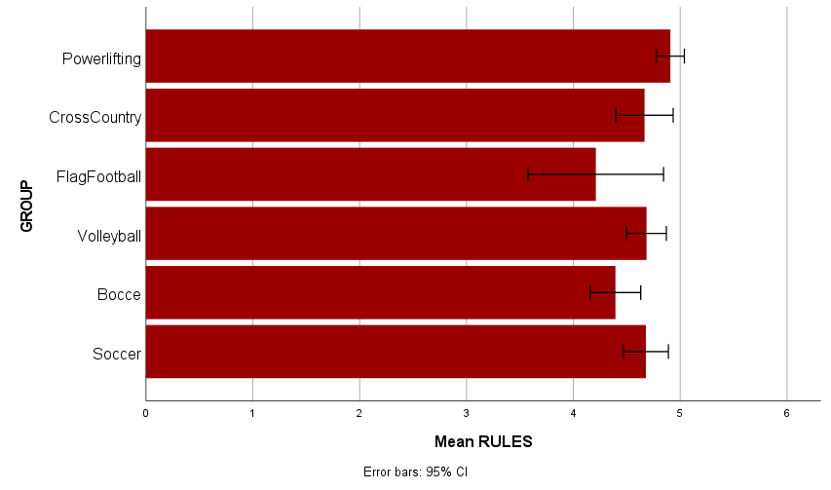
Athlete
GROUP x RULES
Notes:
Tommy

Slide 21
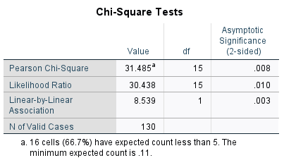
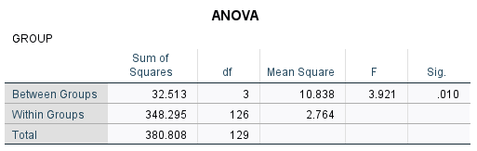
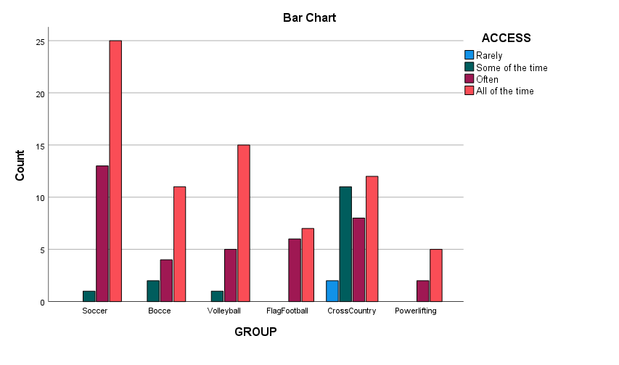
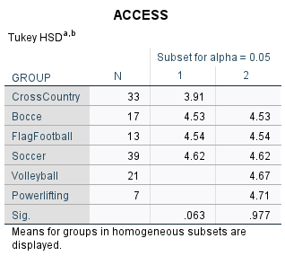
Spectator
GROUP x ACCESS
Notes:
Tommy

Slide 22
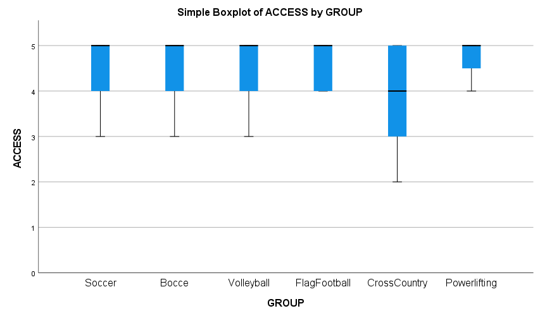
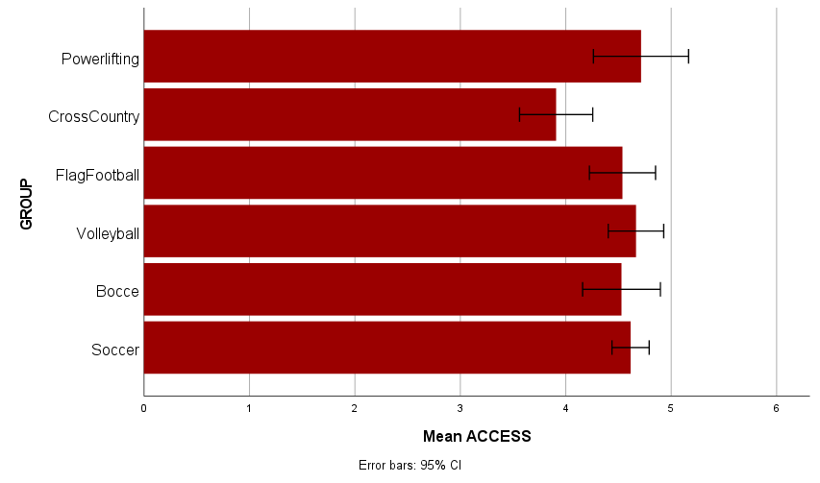
Spectator
GROUP x ACCESS
Notes:
Tommy

Slide 23
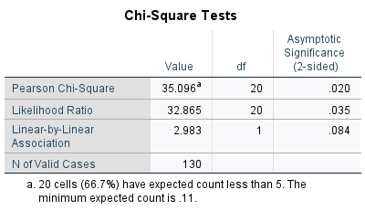

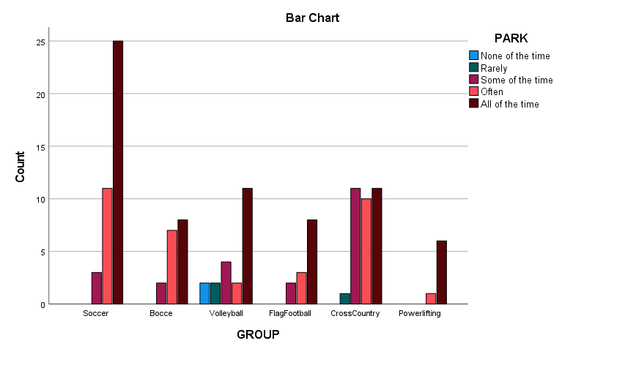
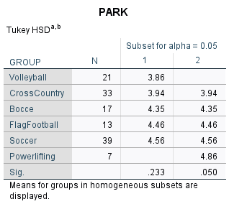
Spectator
GROUP x PARK
Notes:
Tommy

Slide 24
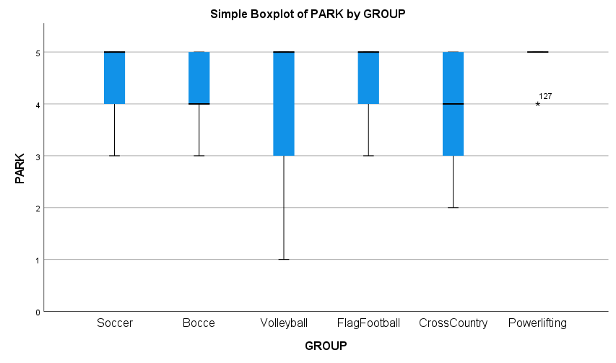
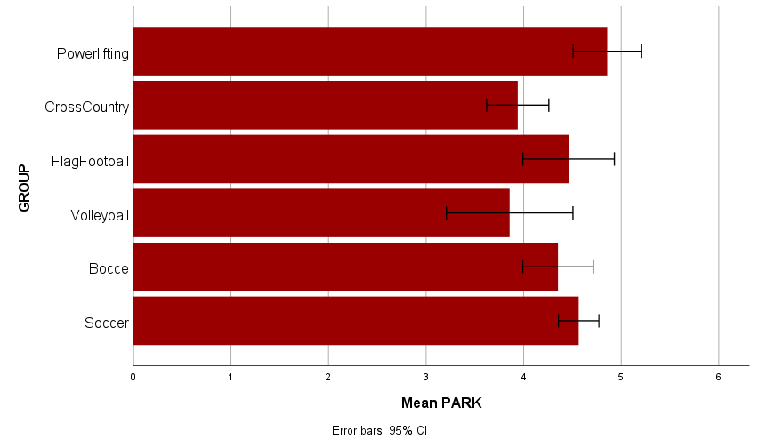
Spectator
GROUP x PARK
Notes:
Tommy

Slide 25
Athlete Recommendations to Increase Satisfaction
Based off Data collected from Athlete Surveys:
Improve clarity of rules procedures in these areas:
Flag football, bocce, cross country, soccer, volleyball
Potential remedies:
Improve clarity of rules procedures in these areas
More training for volunteers in these sports
Notes:
Cole

Slide 26
Spectator Recommendations to Increase Satisfaction
Based off Data collected from Spectator Surveys:
Increase accessibility to these areas:
Cross country, bocce, flag football, soccer
Improve parking procedures to these areas:
Volleyball and Cross Country
Potential remedies:
Implement a shuttle system to make things more accessible
New lots to park: Baseball field, behind maintenance, DUC, soccer fields, etc.
Notes:
Cole

Slide 27
Volunteer Recommendations to Increase Satisfaction
Based off the Focus Group of Six Special O Bocce Volunteers:
Mandatory orientation for refs- (All Six Volunteers)
Health and safety training in case an athlete goes down- (All Six Volunteers)
Better food variety for athletes- (Two Volunteers)
Retain athletic teams and character u participants
Training with in set up and organization of event (Five Volunteers)
Notes:
Cole

Slide 28
Thank you!
Any questions?
Notes:
Kurt

